Slide 1



Team Phoenix
"SMOOTH SKIN, NATURALLY."
Over The Wall
Marico

Slide 2




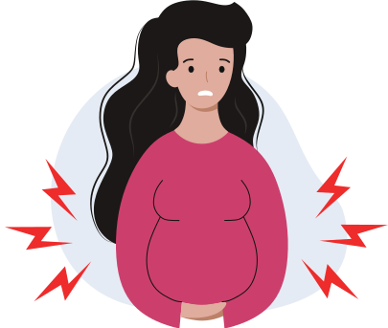
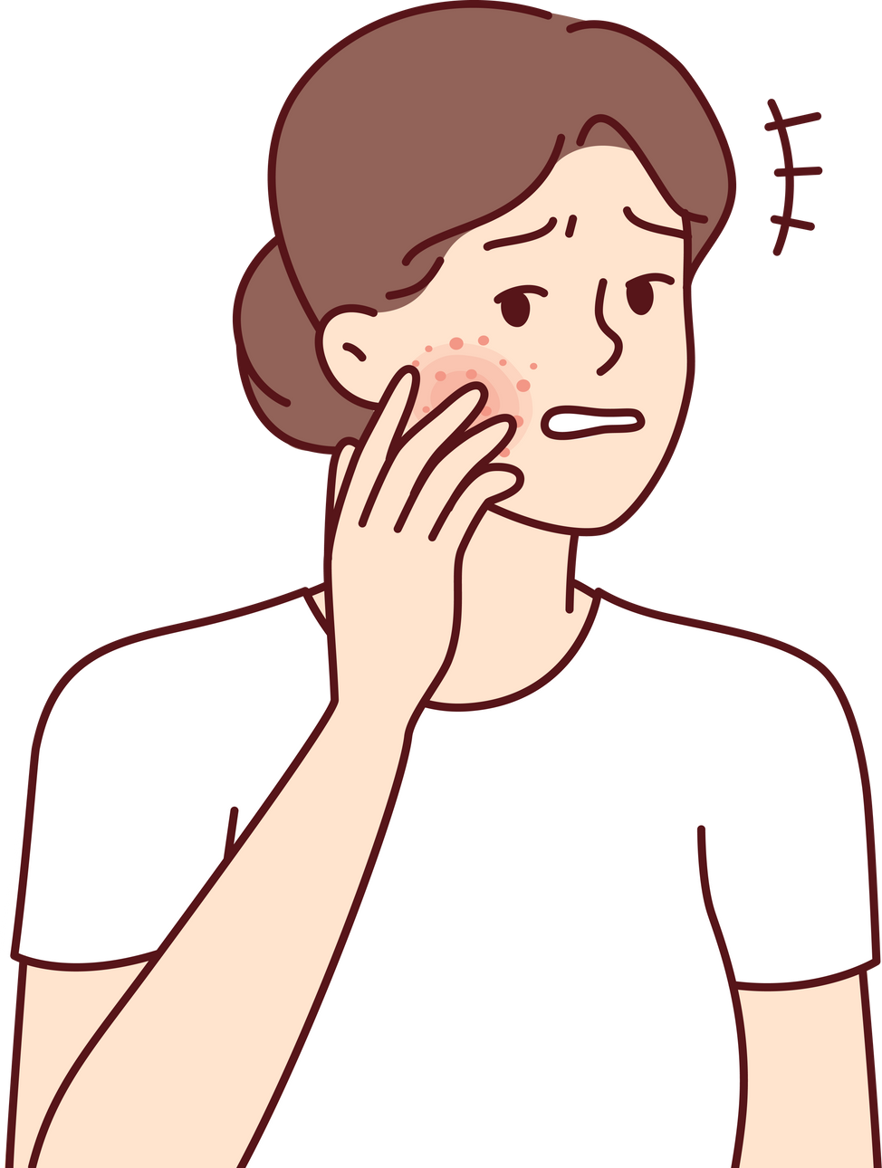

Problem Analysis
Time-consuming and limited Accessibility
Cost and Affordability
Lack of Long-lasting Results
Discomfort and Pain
Skin Sensitivity and Irritation
Hair removal methods such as shaving often require frequent repetition.
Waxing and shaving only temporarily eliminate hair, requiring frequent treatments to maintain smooth skin.
Laser-based hair removal and accompanying products can be expensive.
Hair removal treatments like waxing and epilating can hurt.
Sensitive skin makes hair removal products more uncomfortable and irritating.

Slide 3







Students and Young Adults & Working Professionals
Target Market
Who are the customers we want to cater to?
Urban Consumers & Income Groups
Fashion Enthusiasts & Environment and Religious Considerations

Slide 4





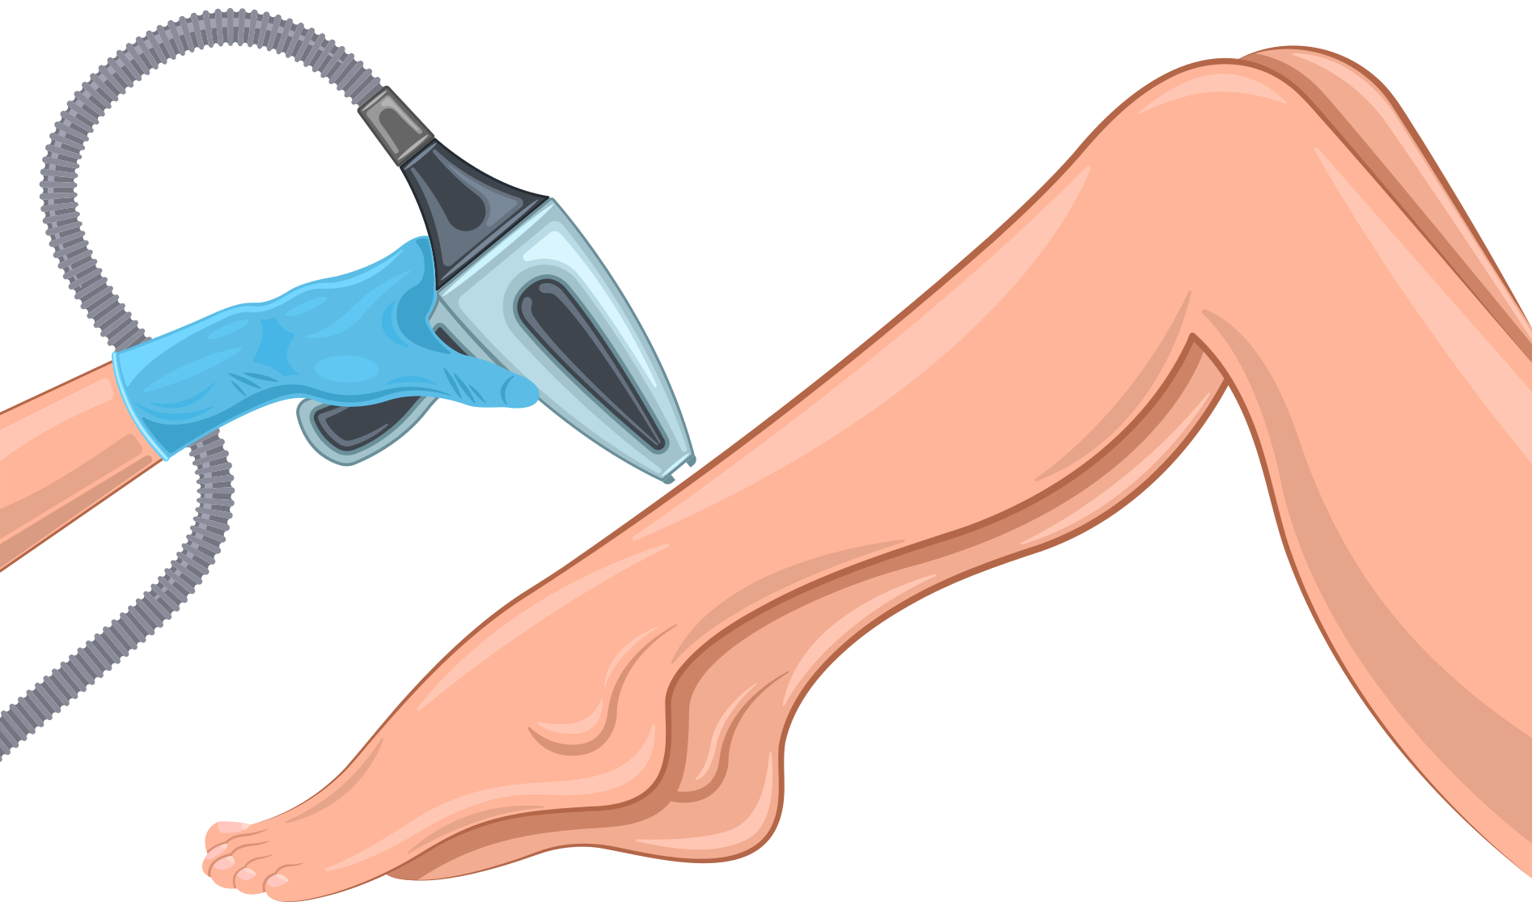



COMPETITOR ANALYSIS
Traditional Methods
Depilatory Creams
Shaving and waxing are popular hair removal treatments. Cheap and fast. They need special care and rarely last.
Depilatory treatments break down hair and make removal easy. Cheap and easy to use, they may smell bad and only work temporarily.
Electric Shavers
Laser Hair Removal
Fast and gentle electric shavers function in wet or dry conditions. They trim and shape but may not shave as close or long as classic razors.
Laser pulses target hair follicles for long-lasting body hair eradication. This pricey, effective method should only be done by professionals.
IPL Hair Removal
Home Waxing Kits
IPL devices are becoming popular laser alternatives. Their light-based hair growth inhibitors may not work as well at home and require constant application.
Home waxing kits are cheaper and easier than salon waxing, but delicate skin may not like them.

Slide 5

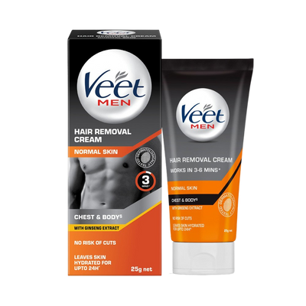
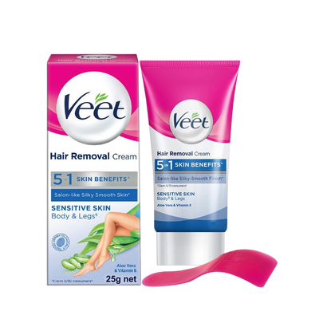
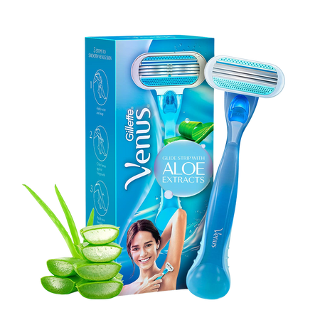
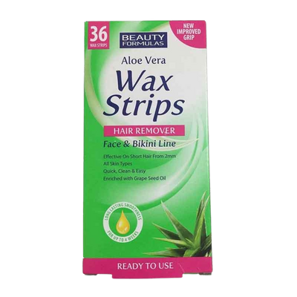
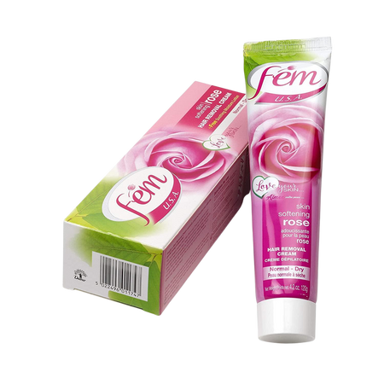
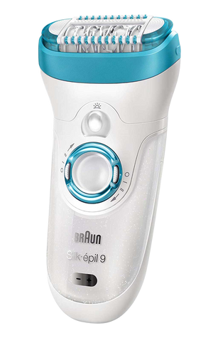
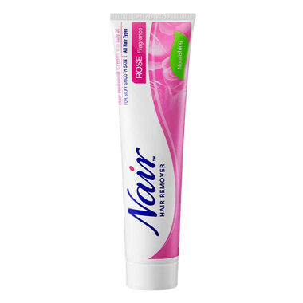
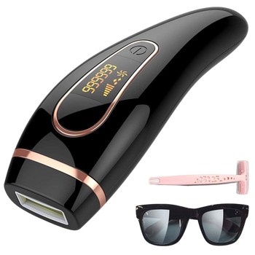
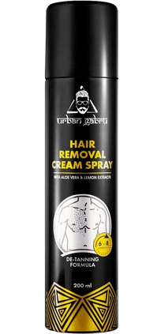
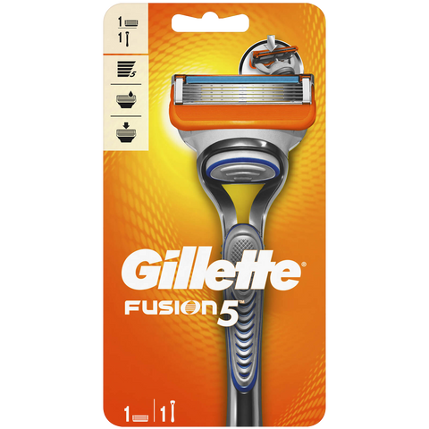
CURRENT PRODUCTS
Gillette & Venus Razors
Veet
Nair
Fem
Waxing Kits
Epilators
Hair Removal Sprays
Laser Hair Removal Devices

Slide 6

Big Idea
Parachute - Soft
"Smooth skin, naturally."
Meet Soft, the latest hair removal cream from Parachute. It's made with natural ingredients and promotes environmental sustainability. Soft caters to different skin types and preferences, providing everyone with a gentle, safe, and sustainable hair removal cream. It's an eco-friendly alternative to chemical-based products, allowing you to bid farewell to harmful chemicals and embrace a sustainable future. Try Soft today and enjoy its gentle and safe effects on your skin.

Slide 7


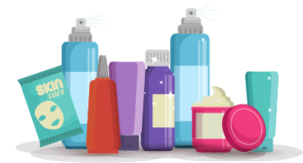

Big Idea Justification
Step 1
Step 2
Step 3
Step 4
Step 5
INCENSEMENT OF NATURAL AND SUSTAINABLE PRODUCTS
APPLICATION AND REMOVAL ARE UNCOMPLICATED, AND THE PACKAGE MAKES PRODUCT DISPENSING EASY.
SUSTAINABLE PACKAGING ATTRACTS ECO-CONSCIOUS SHOPPERS.
DIFFERENTIATION FROM COMPETITORS
CATERING TO DIFFERENT SKIN TYPES AND PREFERENCES
INCREASING LONG LASTING

Slide 8

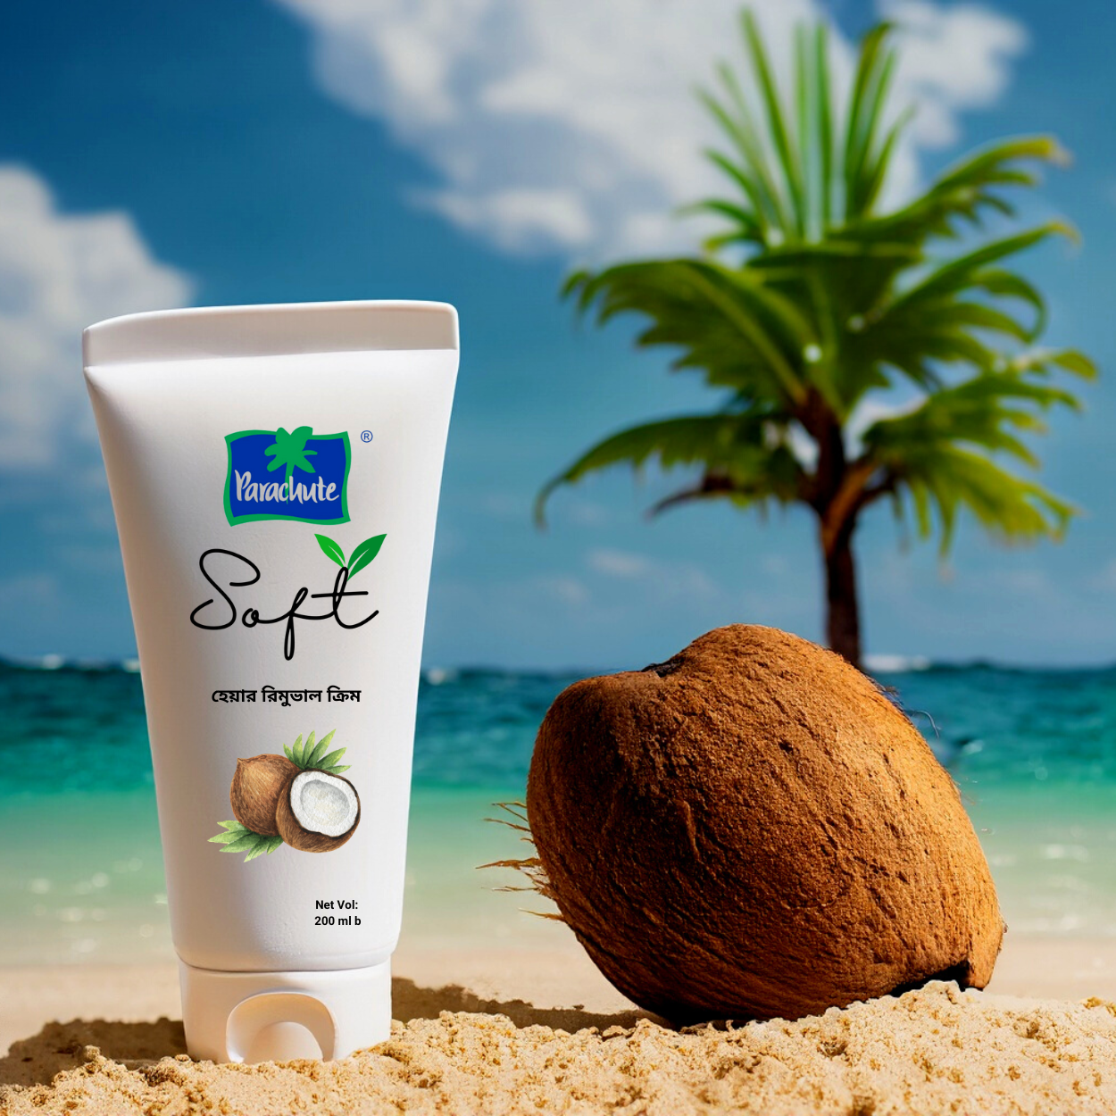

Product Analysis
Minimalist design, pastel colors
Eco-friendly packaging
Biodegradable tube cap

Slide 9





USP for Parachute's Soft
2
1
3
It caters to health-conscious individuals and an eco-friendly option for environmentally conscious consumers.
Come up with natural ingredients, no harsh chemicals & made with eco-friendly and sustainable materials.
It gives skin feeling smooth and soft after hair removal, delivering the desired results for consumers

Slide 10

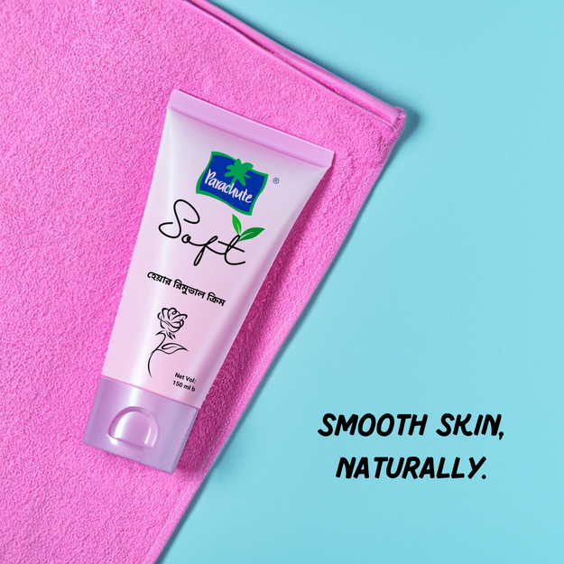
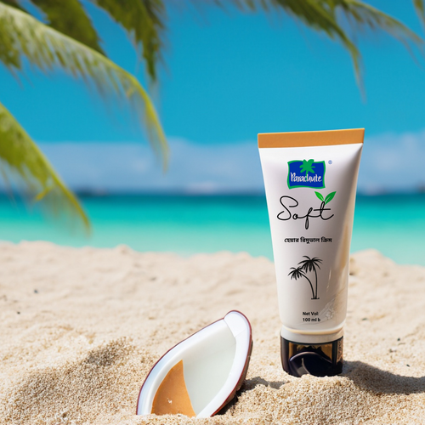


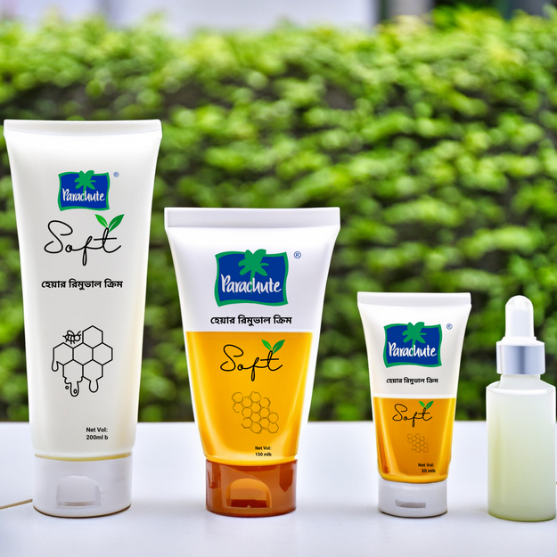
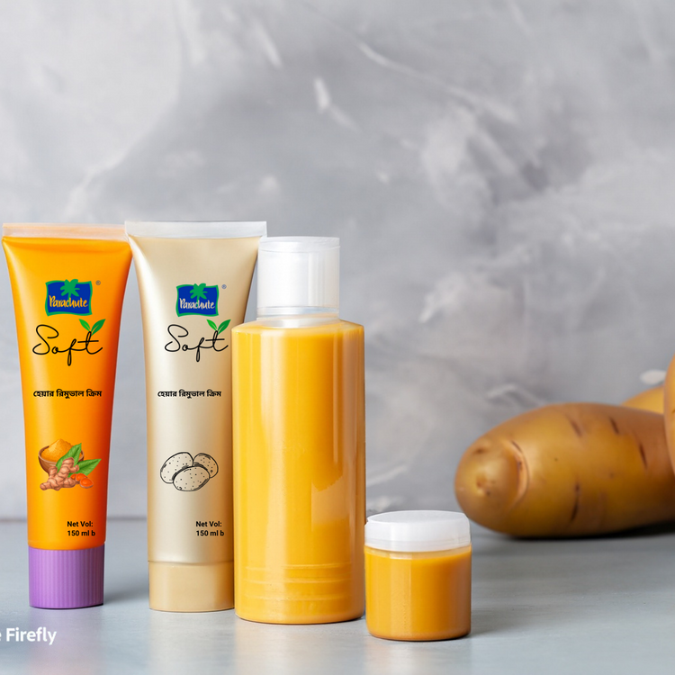
Unique packaging innovation Of Parachute Soft-
We use eco-friendly packaging with a minimalist design in calming colours to reflect our commitment to sustainability and gentleness.
Using biodegradable tubes and cap packages to make products more convenient and user-friendly.

Slide 11


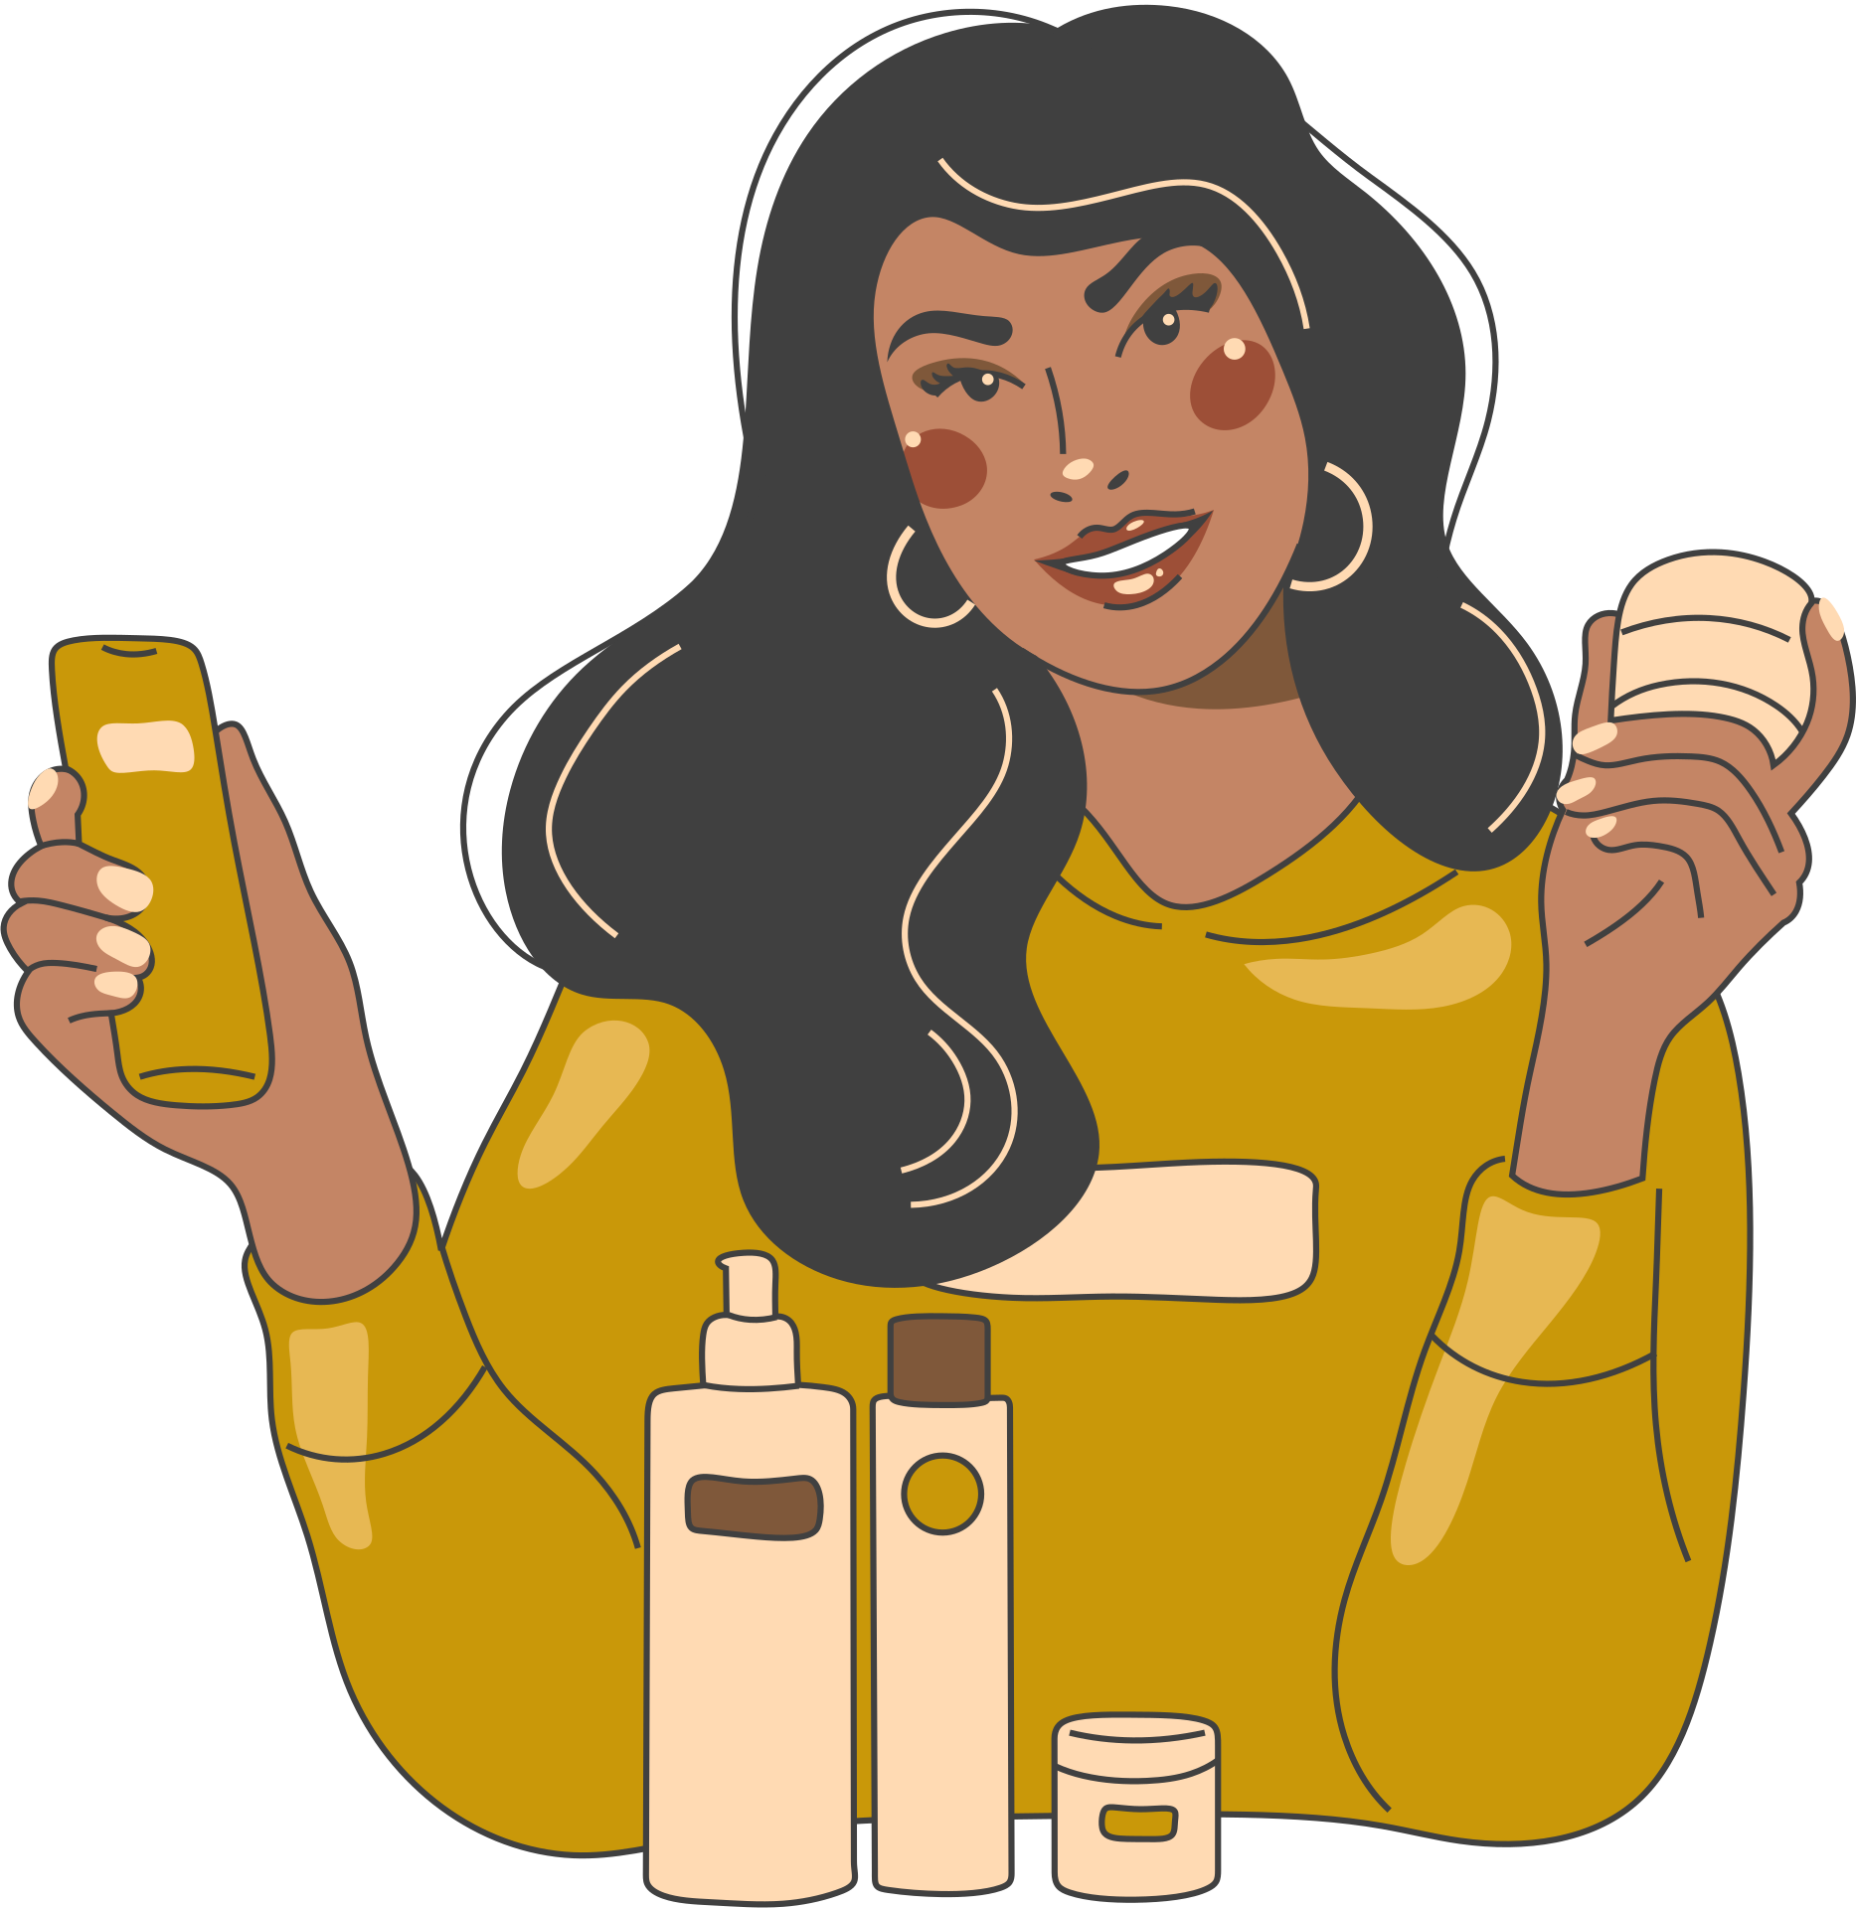



Promotional Strategies
Emphasize the natural ingredients and sustainability of the product
Run educational campaigns about hair removal and skin care.
Collaborate with local influencers and beauty bloggers.
Offer special promotions and discounts at launch.
Promote the product throughout holidays and festivals to reach consumers and generate buzz.
Team up with local nonprofits. This can boost community trust and brand exposure for Parachute.

Slide 12






Campaign Name:
“Smooth and Sustainable with Soft”
Create a Social Media Buzz
Launch a Website
Host a Giveaway
Partner with Sustainable Brands
Measure and Analyze Results
Make a teaser video about Soft's natural ingredients and benefits.
Use #sustainablebeauty, #naturalhairremoval, and #parachutesoft to gain awareness.
Partner with beauty and sustainability influencers to promote the product.
A Soft website should highlight its qualities, benefits, and ingredients.
Consumer evaluations and testimonials establish confidence and trustworthiness.
Give customers a free trial or discount voucher to try the goods.
Host social media giveaways to attract new clients. Encourage participants to share their hair removal experiences and natural product preferences.
Offer Soft as the grand prize and other sustainable beauty products as runners-up.
Partner with sustainable brands to cross-promote.
Offer a bundle of Soft and other ecological beauty products at a discount.
Join social media campaigns and events to promote your brand.
Track website traffic, social media activity, and sales with analytics.
Use consumer reviews to improve product and marketing.
Optimise marketing efforts and consumer happiness with the data.

Slide 13





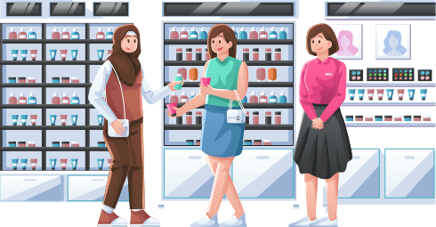









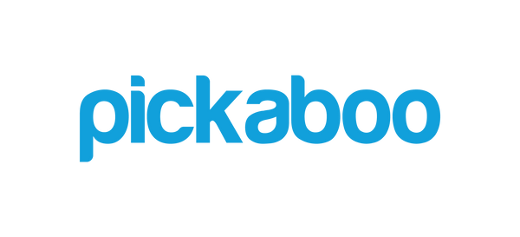
DISTRIBUTION
Channel
General Trade / Store
Pharmacy shop
Urban Neighborhood Grocer
Modern Trade
Cosmetics Stores
Rural Wet Market Grocer
E-Commerce Store

Slide 14




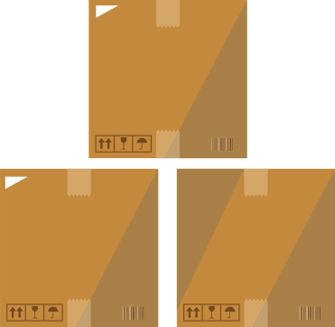


SUPPLY CHAIN
STRATEGY
Procurement of raw material
Determining the quality
Factory production
Factory finished goods
Retailer and vendors
Customers
Inbound logistics activities
Outbound logistics activities
Raw materials:
• Paraffinum Liquidum
• Cetearyl Alcohol
• Calcium Hydroxide
• Thioglycolic acid
• Glycerin
Sourcing materials:
• Coconuts: Sri Lanka
• Banana: Noakhali, Bangladesh
• Honey: Sundarbans; 75% natural honey.
• Papaya: Tangail & India.
• Aloe Vera: Rajasthan, India
• Banana
• Coconut
• Sugar
• Papaya
• Felatin
Packaging Materials
To ensure the quality and effectiveness of your hair removal cream, it's important to store it in a cool and dry location that's shielded from sunlight. Parachute sources packaging from China to provide dependable protection for your product.

Slide 15
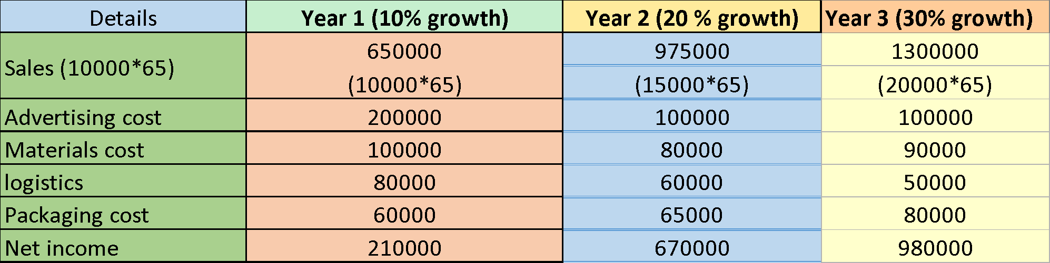
Current and projected revenue for next 3 years
Details

Slide 16
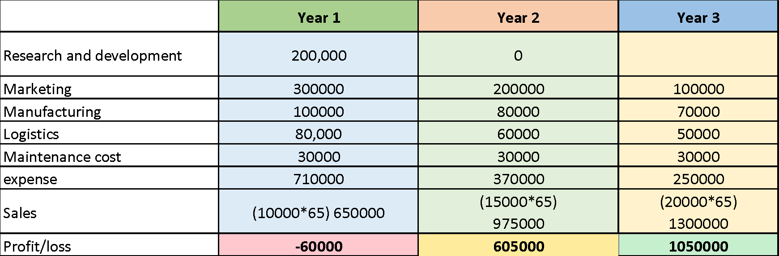
Profit and loss road map
Details

Slide 17

Appendix
Wresearch. (n.d.). Bangladesh Hair Care Market (2022-2028) | Trends, Value. 6Wresearch. https://www.6wresearch.com/industry-report/bangladesh-hair-care-market-2020-2026
https://www.indianretailer.com/article/whats-hot/retail-trends/what-are-the-challenges-in-selling-natural-and-organic-products-online.a8126
Over The Wall

